Slide 1
The Ancient Turks and Their Culture
Lecture #7

Slide 2
Ancient Turkic Khaganates
The First Turkic Khaganate (552 CE –744 CE) established by the Ashina clan of the Göktürks in medieval Inner Asia. Under the leadership of Bumin Qaghan (d. 552) and his sons, the Ashina ascended to the hegemonic power of the Mongolian Plateau
The first Turkic Khaganate collapsed in 581, after which followed a series of conflicts and civil wars which separated the polity into the Eastern Turkic Khaganate and Western Turkic Khaganate.
The Eastern Turkic Khaganate was subjugated by the Tang dynasty in 630 and the Western Turkic Khaganate disintegrated around the same time

Slide 3
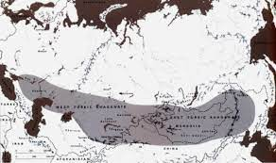

Slide 4
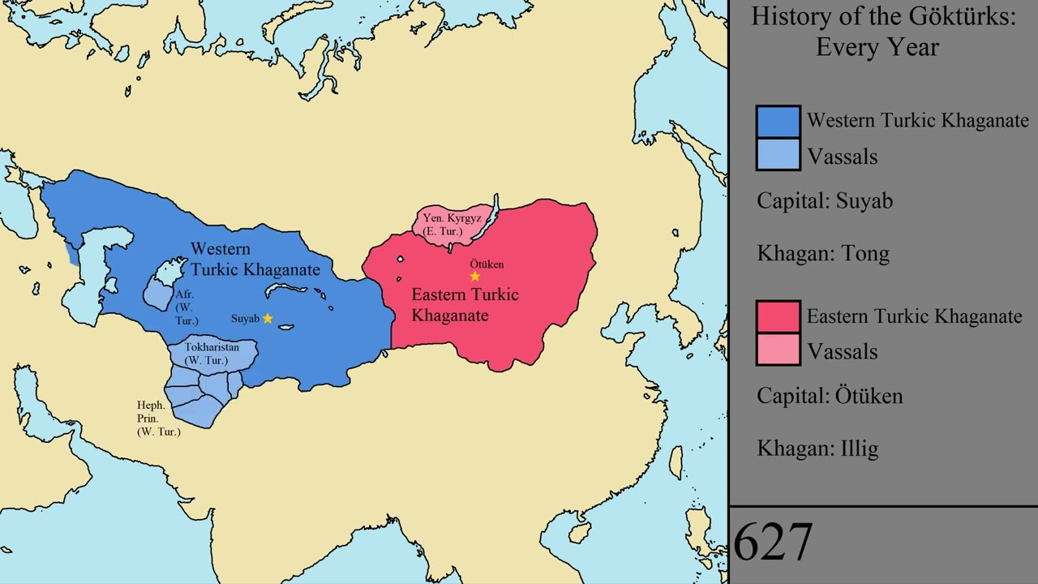

Slide 5
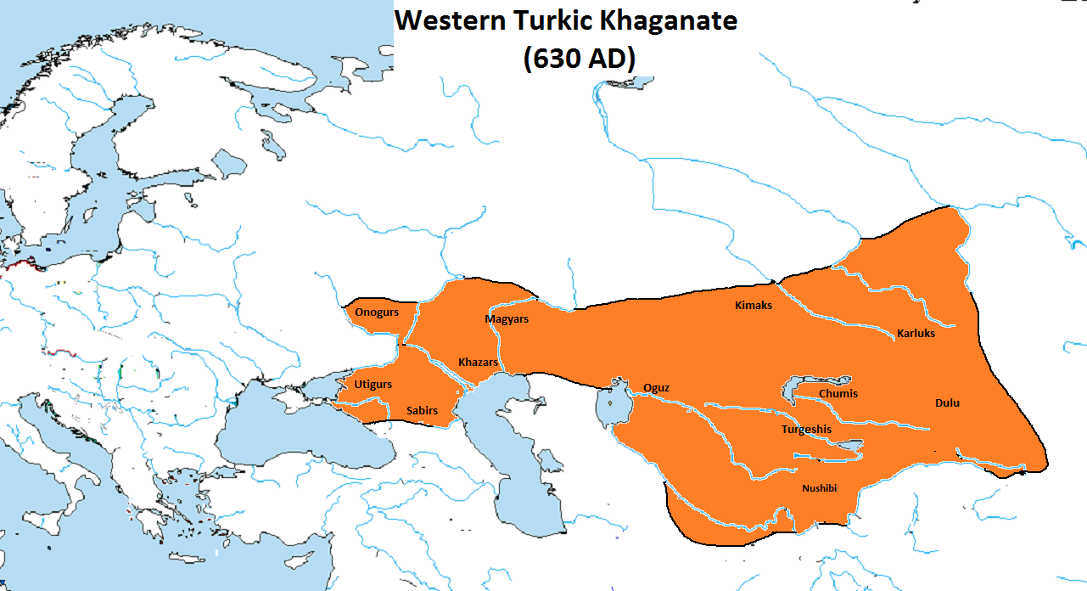

Slide 6
Second Turkic Khaganate (ca. 682-745 AD)
centered on Ötüken in the upper reaches of the Orkhon River overthrown by
Uyghur Khaganate (745-840), a different Turkic group.
Enisei Kyrgyz Khaganate (840-924)
Turgesh Khaganate (704-756)
Khazar Khaganate (650–969)

Slide 7
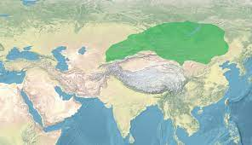

Slide 8
The Old Turkic Script
Known as Orkhon script, Orkhon-Yenisey script, Turkic runic script. Words were written from right to left.
First discovered in the Orkhon Valley in Mongolia in 1889 by Nikolai Iadrintsev, first published by Vasily Radlov and deciphered by the Danish philologist Vilhelm Thomsen in 1893.
A Yenisei variant is known from the 9th-century Kyrgyz inscriptions and a Talas variant from the Talas Valley in Turkestan.

Slide 9
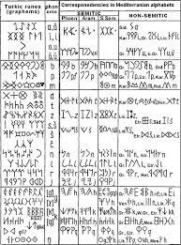
Origin
ancient Semitic and non-Semitic languages

Slide 10
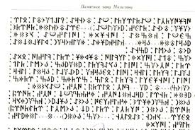

Slide 11
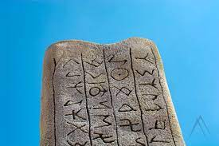

Slide 12
